Slide 1
MATLAB PROJECT ASSIGNMENT
GROUP 8

Slide 2
MATLAB QUESTION
Engineers always face challenges in the following areas; storm water management, water supply and piped irrigation design, hydrological delineation and runoff estimation, yield estimation in crop production. Design a high end of matlab code to design and stimulate any projects provided, ensure to use any available tool fits.

Slide 3
The problem focused upon and core components considered
Uncertainity in the estimation of crop yield in production and agriculture and core components considered include;
Data processing and processing module
Multimodel machine learning framework
Proccess-Based simulation engine
Ensemble learning system
Spatial analysis and visualization dashboard
Uncertainity quantification module
Management insights generator

Slide 4
Considerations under data generation and proccessing
Meteorological data which include; temperature, precipitation and growing degree days.
soil properties eg nitrogen content, PH, organic matter
Management practices eg fertilizer application, irrigation levels.
Satelite derived indices eg NDVI, EVI etc

Slide 5
Data Assurances
Missing value handling using moving median
Feature normalization using z-score standardization
Yield target validation (minimum 2 tons/hectare)

Slide 6
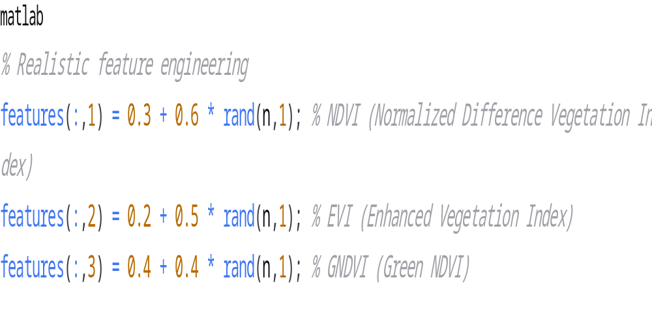
Matlab code

Slide 7
Machine learning framework considerations
Machines considered here include;
gradient boasting machine
support vector machine
The architecture employed is the neutral network architecture and this includes;
Hidden layers: [20, 10] neurons
Early stopping with 10 validation failures
100 training epochs maximum

Slide 8
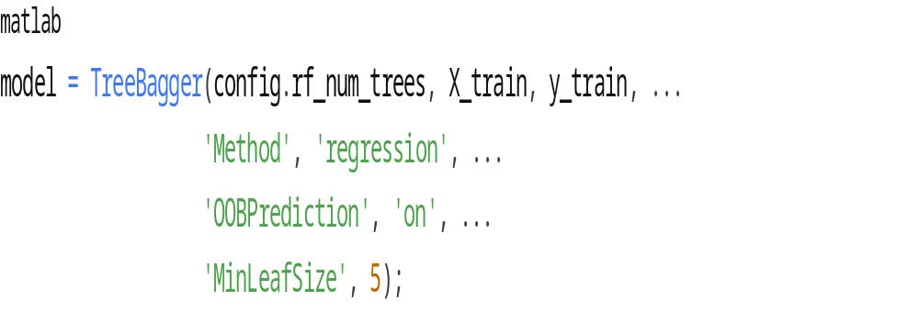
Matlab codes considered
Random forest implementation

Slide 9
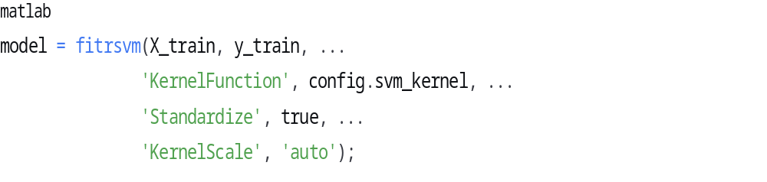
Saw vector machine code and its features
Features:
Gaussian kernel for non-linear relationships
Automatic kernel scaling
Robust error handling with linear kernel fallback

Slide 10
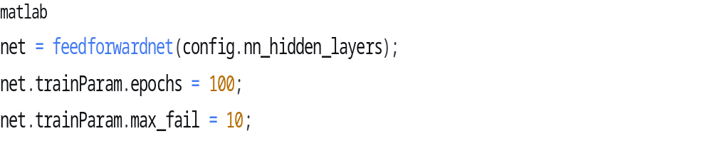
Nueral network architecture
Architecture:
Hidden layers: [20, 10] neurons
Early stopping with 10 validation failures
100 training epochs maximum

Slide 11
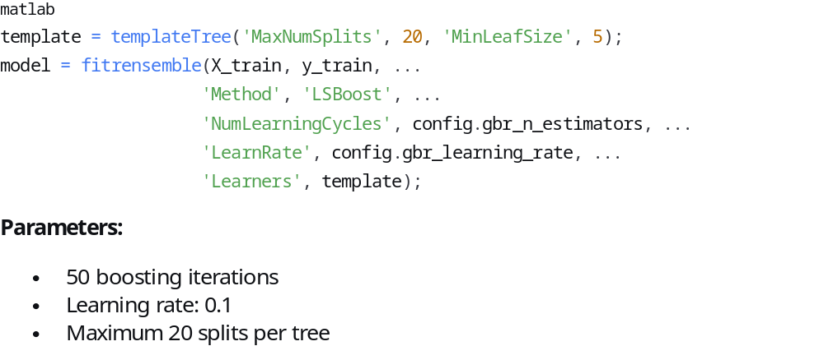
Gradient boasting machine code and its parameters

Slide 12
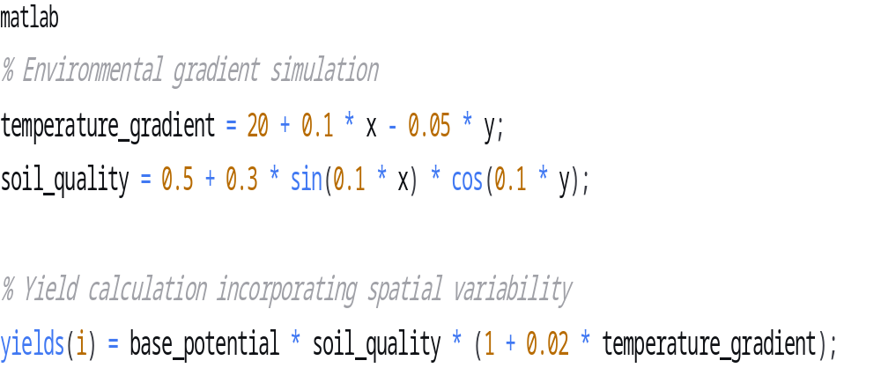
Proccess- based crop simulation code

Slide 13
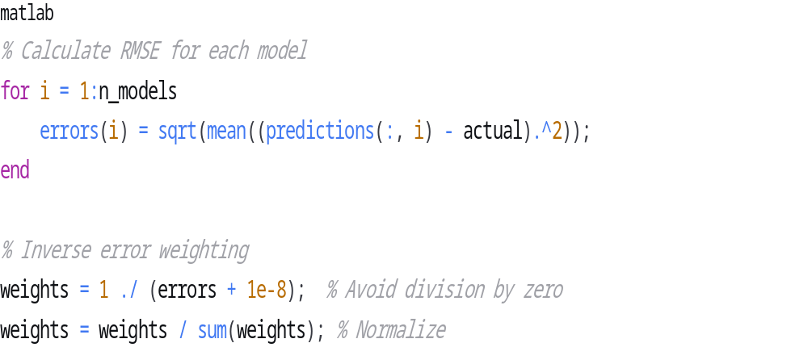
Ensemble learning system code

Slide 14
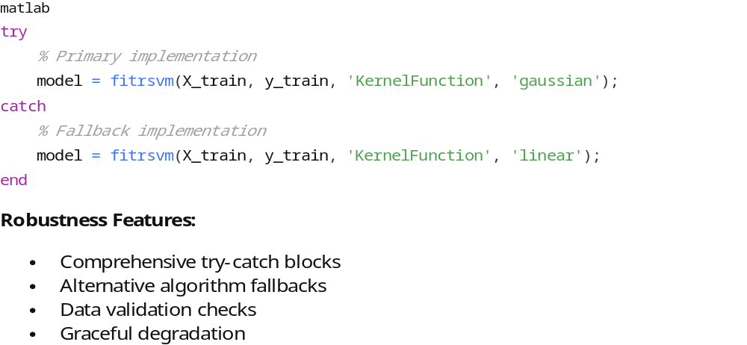
Error Handling and robustness code and its features

Slide 15
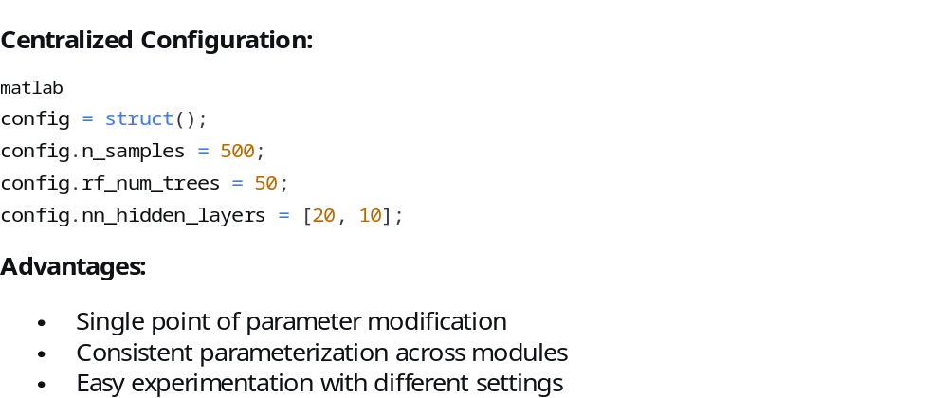
Configuration management code and its advantages

Slide 16
Performance analysis and resource requirement estimates
Predicted Performance Metrics:
Ensemble Model: RMSE: 0.5-0.8 tons/ha, R²: 0.85-0.95
Individual Models: RMSE: 0.6-1.2 tons/ha, R²: 0.75-0.90
Uncertainty: Coefficient of Variation: 8-12%
Resource requiremets;
Execution Time: 2-5 minutes (standard desktop)
Memory Usage: 200-500 MB
Storage: Minimal (in-memory processing)

Slide 17
Conclusion
The implemented Crop Yield Estimation System represents a sophisticated integration of machine learning and agricultural science. Key strengths include:
Comprehensive Methodology: Multiple modeling approaches with ensemble integration
Robust Implementation: Extensive error handling and validation
Practical Relevance: Direct applications in precision agriculture
Scalable Architecture: Modular design for future enhancements
The system successfully demonstrates the potential of computational intelligence in agricultural decision support, providing a solid foundation for both research and practical applications in crop yield estimation

